Slide 1


Covid – 19 Restrictions and their effect on the spread of the virus
Aaron Kohn
Notes:
Read title
Name
Since the start of covid
Regulations implemented
What effect

Slide 2
Mask Mandates 0 = No mandate 1 = Mandated
Gathering Bans 0 = No Ban. 1 = Bans over 101 People. 2 = Bans 51 – 100 People. 3 = Bans 26 – 50 People. 4 = Bans 11 – 25 People. 5 = Bans 1 – 10 People. 6 = Bans all gatherings.
Notes:
The regulations implemented include mask mandates, gathering bans, restaurant restrictions and stay at home oreders.
These regulations have benn implemented to various severitys.

Slide 3
Restaurant Restrictions 0 = No Order Found 1 = Authorized to reopen 2 = Open with reduced seating and enhanced sanitation. 3 = Open with reduced seating and enhanced sanitation. 4 = Curbside/delivery only. 5 = Closed
Stay at Home Orders 0 = No Orders 1 = Recommendation 2 = Mandatory for at risk individuals in certain areas 3 = Mandatory for at risk individuals. 4 = Mandatory for all in certain areas. 5 = Mandatory for all
Notes:
Both the order code which increases in severity as the number rises and the order rules are used in this study.

Slide 4
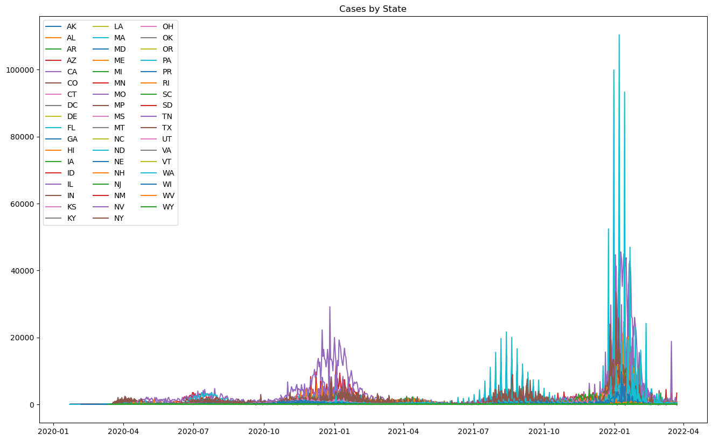
Daily new cases as reported by the states
Notes:
The daily new cases as reported by the states are used.

Slide 5
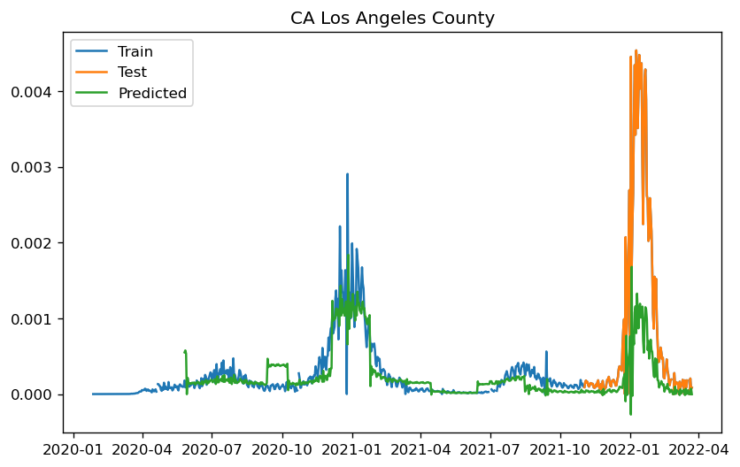
Predictions of model including Restrictions
Mode for Los Angeles County including restrictions. R2-score = 0.1030
Notes:
In an attempt to create a model to predict daily deaths using statsmodels sarimax on the La county data the f2 score was just 0.103
This model included restrictions

Slide 6
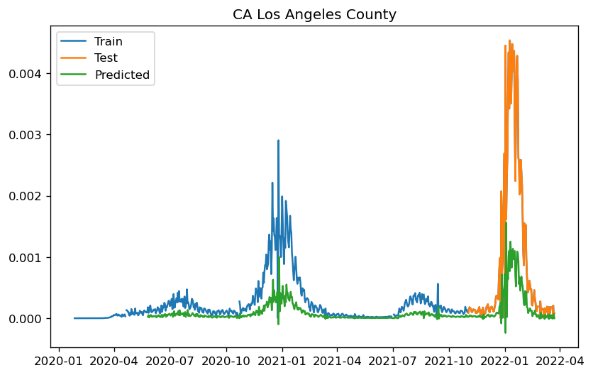
Predictions of model without Restrictions
Mode for Los Angeles County without restrictions. R2-score = 0.0795
Notes:
When restrictions were removed as a predictor the r2 score drops to 0.0795. The average socres for all counties are even lower. Including or removing restrictions has little to no effect.

Slide 7
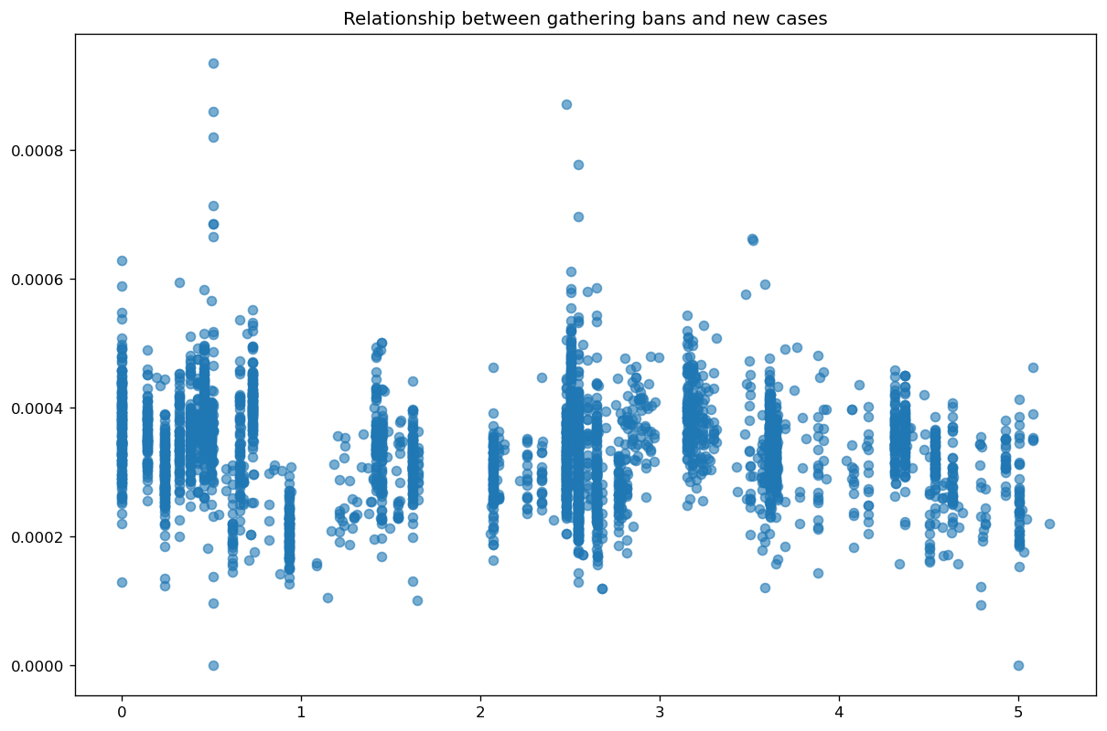
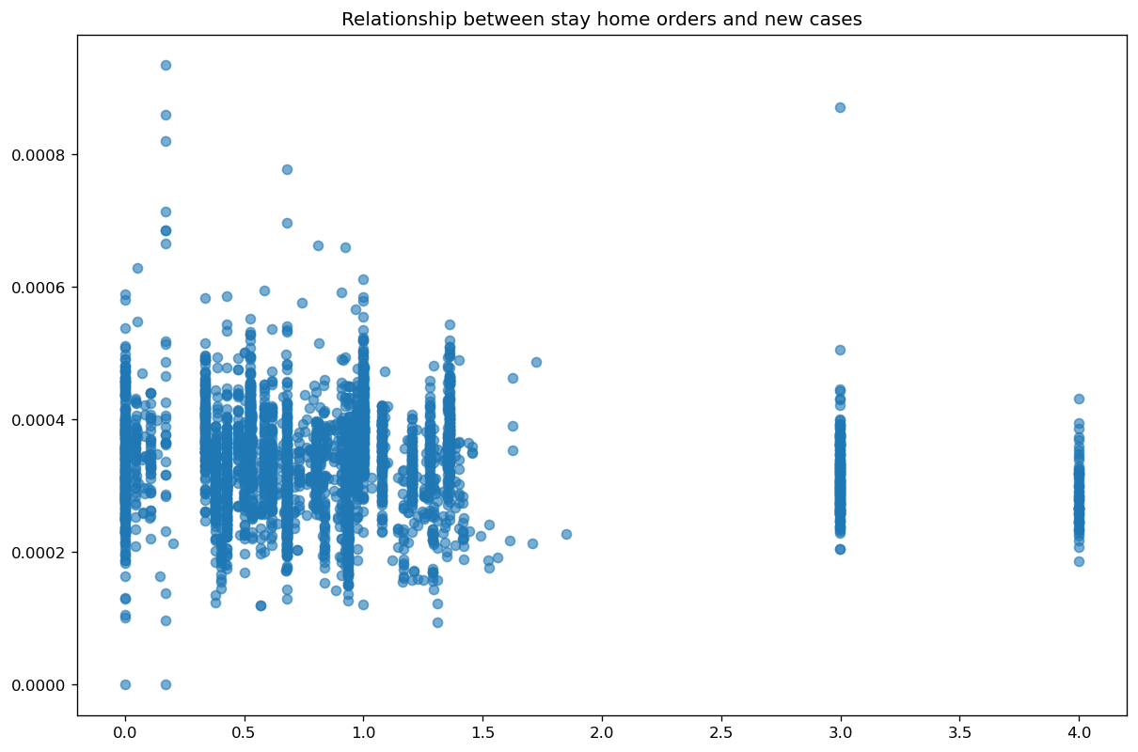
Correlation of new cases to gathering bans and stay at home orders
Correlation = -0.072
Correlation = -0.044
Notes:
There is a slight negative correlation …..
This measure is achieved …..

Slide 8
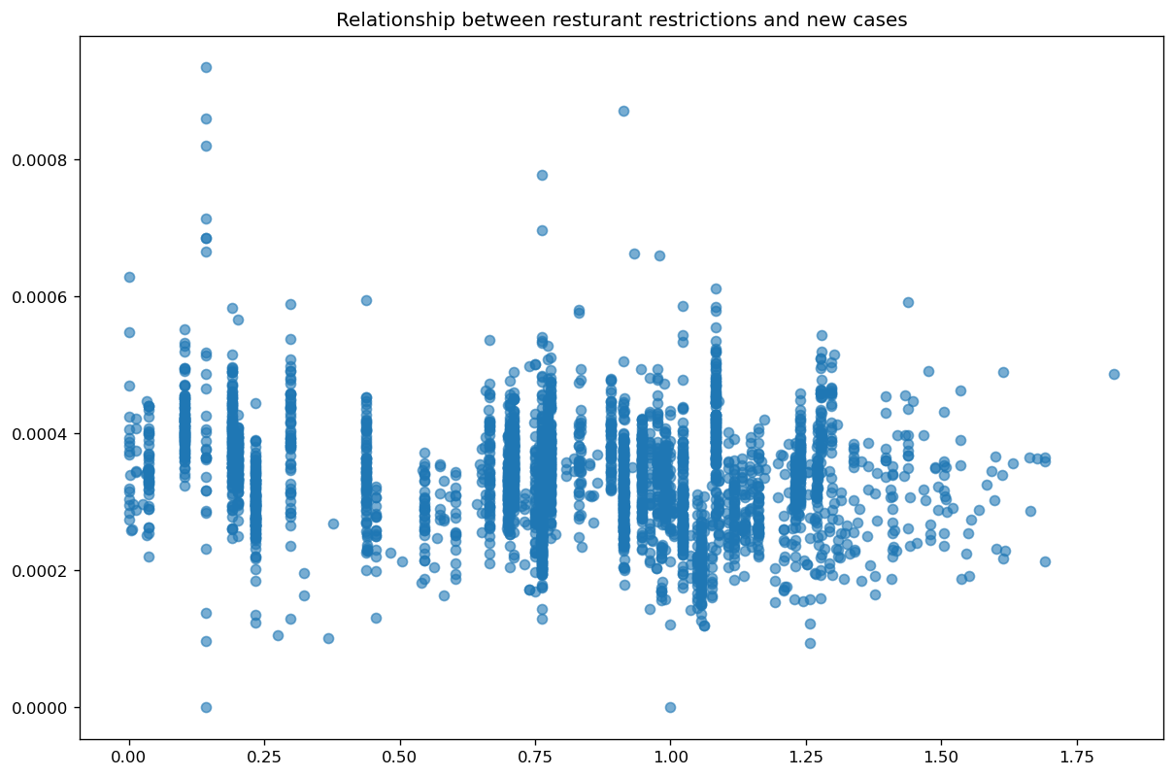
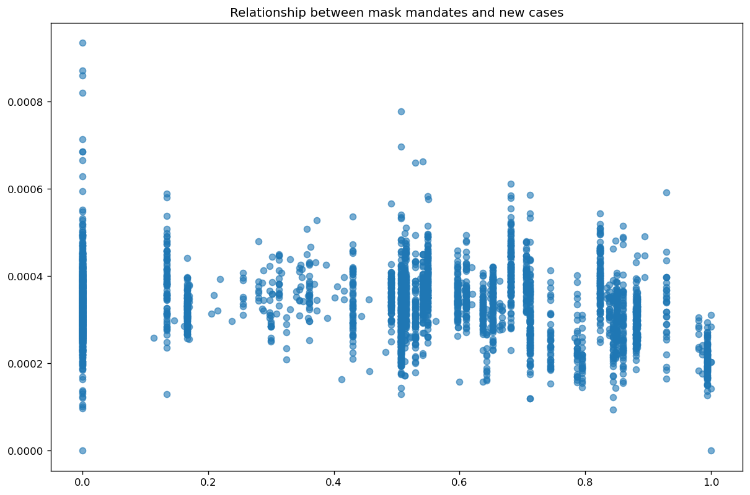
Correlation of new cases to restaurant restrictions and mask mandates
Correlation = -0.152
Correlation = -0.142
Notes:
Further analysis may be warented to determine the best level

Slide 9
Recomendations
Tentatively suggest slight benefit of regulations.
Implement better models to increase accuracy
Use improved models to measure effect of regulations
Notes:
In conclusion the re appears to be some benefit ..
Better models needed ..
Once accucracy ….

Slide 10
Questions
Why was the target value of new cases chosen above other variables? This value was chosen despite some concern regarding the way testing was initially done. New cases was chosen over new deaths since smaller counties have larger stretches with reports of no deaths.
How accurate and reliable is the data? The data is as reported to the Center for disease control by the states. There may some concern regarding different standards of reporting by different states.
Are state testing guidelines controlled for? All data is as reported by the states. No other factors are taken into account other than the mandates.
How does interstate travel affect the results? No consideration has been made for travel. It is unclear if tests preformed on those from outside the county are reported as part of the county of residence or where the test was preformed.
What role do federal guidelines play? The guidelines used for the study are the ones in effect at that time. If federal guidelines overrule local laws then it would be reflected in the data for the county.

Slide 11
Questions
Are penalties for mandates accounted for? No. How the mandates are enforced was not part of the data.
What effect does average age of population have? Age was not used in this study.
Is it possible to predict the number of cases for a county if no regulations had been implemented? The low performance level of the model, has ruled out the benefits of such an attempt.
If a modest or very low benefit is determined would the regulation still be recommended? Obviously, the value of a life cannot be measured. However, modeling against economic effects and other costs would aid in such decisions.
Are mandates enacted as a result of case numbers? It can be assumed that to some extent yes. Still there appears to a correlation between lower case rates and stricter regulations. However, it may be a result of lower initial reporting numbers as discussed earlier.

